Slide 1
Welcome to Guided Studies!
You made it through the day! Please find a seat wherever you like (for today).
Ms. Holstad, Mrs. Moberly, and Ms. Bynum

Slide 2
What is Guided Studies?

Slide 3
What is Guided Studies?
Time for you to get work done at the end of the day!
You will have two jobs in this class
1. ORGANIZE
2. WORK
We are here to help!

Slide 4
Who are your teachers?

Slide 5
Who are your teachers?
Ms. Holstad (math and learning strategies)
Mrs. Moberly (biology)
Ms. Bynum (biology)

Slide 6
Who are you?

Slide 7
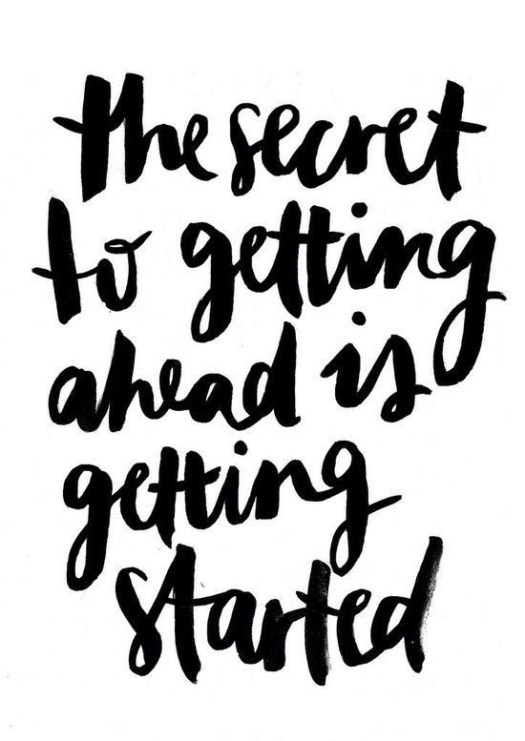
Who are YOU?
The most important part of this class is YOU.
Whatever you put into this time is what you will get out of it

Slide 8
Who are YOU?
Tell us a bit more about yourself!
Please be as open and honest in your answers as you can be, so that we can support you the best we can!

Slide 9
Do Work!
https://www.youtube.com/watch?v=RwlhUcSGqgs

